Slide 1
COMPANY PROFILE
NO. 1 STOCK-BROKER IN INDIA

Slide 2
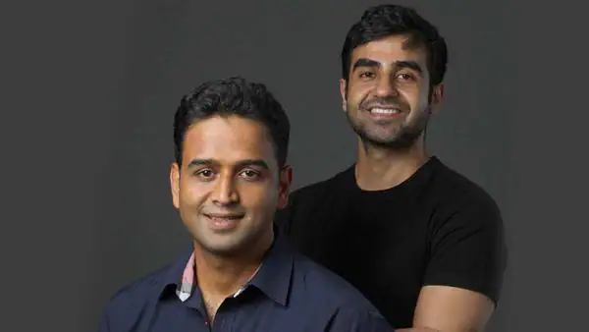
Introduction to Kamath Brothers
Nithin Kamath and Nikhil Kamath are the founders of Zerodha.
Nithin was a telemarketer before Zerodha when he became interested in the stock markets and started using his savings to trade stocks.
Seeing the gap in the Indian stockbroking industry, Nithin decided to start Zerodha with his brother Nikhil, who also had experience in stock trading.
Zerodha was launched in 2010, disrupting the industry and becoming one of the first online brokerages in India to offer “discount brokerage”.
NITHIN KAMAT & NIKHIL KAMAT

Slide 3
ABOUT US
1000+ Employees
Over 1+ crore clients
15% of all Indian retail trading volumes
Flat Rs. 20 or 0.03% (whichever is lower) per executed trades.
Legitimate Stockbroker of India
Works under the regulations by SEBI and RBI
Zero Brokerage for Equity Delivery Trades and Direct Mutual Funds
Low Trading Free and Registered Entity
Zerodha, a discount broker in India, was founded with the goal to disrupt the barriers that traders and investors faced in the Indian market. Some of them include high costs, lacklustre support, and antiquated technology.
The company’s name Zerodha is a blend of the words ‘Zero’ and ‘Rodha’ – a Sanskrit word that signifies a ‘barrier’.
Zerodha continues to empower retail traders and investors through popular open online educational initiatives and community efforts.
Zerodha is relentless in its pursuit of innovation and strives to keep its community informed through frequent updates on its blog and media appearances.
Zerodha Broking Ltd since its inception in 2010 has continued to make its mark in the Indian Stock Market.

Slide 4
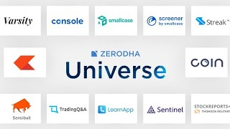
OUR PRODUCTS

Slide 5
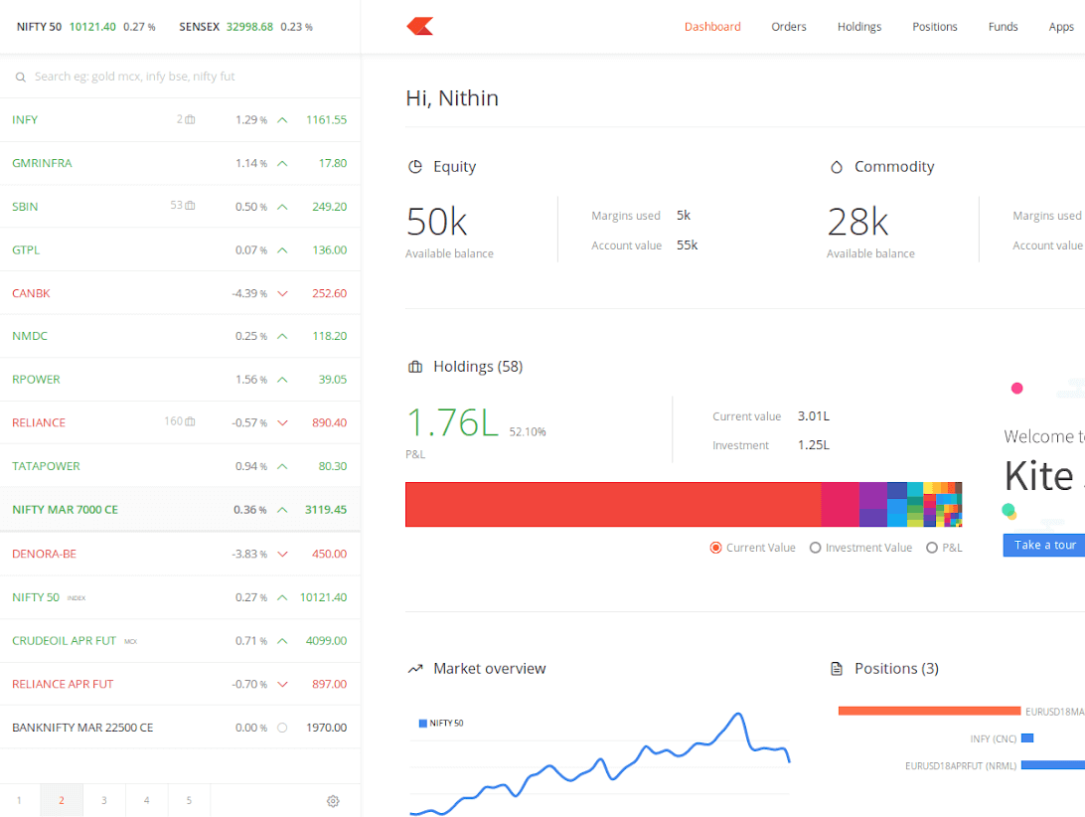
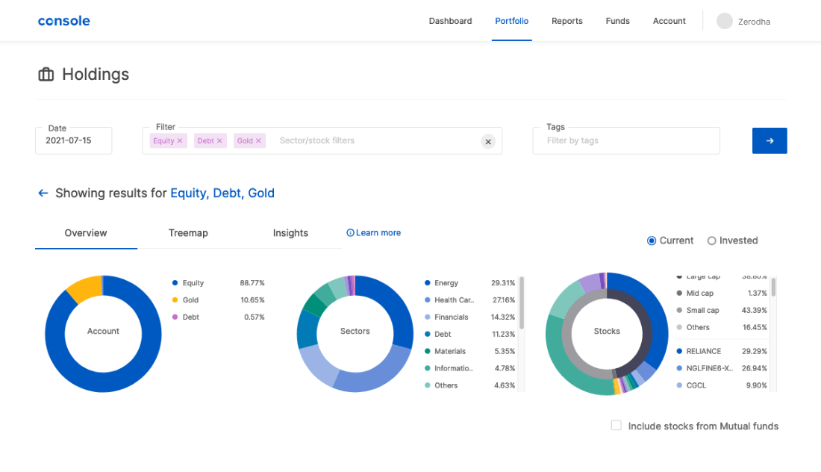
OUR PRODUCTS
KITE
CONSOLE

Slide 6
LIST OF CHARGES – EQUITY
Brokerage | Zero Brokerage | 0.03% or Rs. 20/executed order whichever is lower | 0.03% or Rs. 20/executed order whichever is lower | Flat Rs. 20 per executed order
STT/CTT | 0.1% on buy & sell | 0.025% on the sell side | 0.0125% on the sell side | 0.125% of the intrinsic value on options that are bought and exercised 0.0625% on sell side (on premium)
Transaction charges | NSE: 0.00325% BSE: 0.00375% | NSE: 0.00325% BSE: 0.00375% | NSE: 0.0019% BSE: 0 | NSE: 0.05% (on premium) BSE: 0.005% (on premium)
GST | 18% on (brokerage + SEBI charges + transaction charges) | 18% on (brokerage + SEBI charges + transaction charges) | 18% on (brokerage + SEBI charges + transaction charges) | 18% on (brokerage + SEBI charges + transaction charges)
SEBI charges | ₹10 / crore + GST | ₹10 / crore + GST | ₹10 / crore + GST | ₹10 / crore + GST
Stamp charges | 0.015% or ₹1500 / crore on buy side | 0.003% or ₹300 / crore on buy side | 0.002% or ₹200 / crore on buy side | 0.003% or ₹300 / crore on buy side

Slide 7
LIST OF CHARGES – CURRENCY
Zerodha charges | Currency futures | Currency options
Brokerage | 0.03% or ₹ 20/executed order whichever is lower | ₹ 20/executed order
STT/CTT | No STT | No STT
Transaction charges | NSE: Exchange txn charge: 0.0009% BSE: Exchange txn charge: 0.00025% | NSE: Exchange txn charge: 0.035% BSE: Exchange txn charge: 0.001%
GST | 18% on (brokerage + SEBI charges + transaction charges) | 18% on (brokerage + SEBI charges + transaction charges)
SEBI charges | ₹10 / crore + GST | ₹10 / crore + GST
Stamp charges | 0.0001% or ₹10 / crore on buy side | 0.0001% or ₹10 / crore on buy side

Slide 8
LIST OF CHARGES – COMMODITY
Zerodha charges | Commodity futures | Commodity options
Brokerage | 0.03% or Rs. 20/executed order whichever is lower | ₹ 20/executed order
STT/CTT | 0.01% on sell side (Non-Agri) | 0.05% on sell side
Transaction charges | Group A Exchange txn charge: 0.0026% Group B: Exchange txn charge: CASTORSEED - 0.0005% KAPAS - 0.0026% PEPPER - 0.00005% RBDPMOLEIN - 0.001% | Exchange txn charge: 0.05%
GST | 18% on (brokerage + SEBI charges + transaction charges) | 18% on (brokerage + SEBI charges + transaction charges)
SEBI charges | Agri: ₹1 / crore + GST Non-agri: ₹10 / crore + GST | ₹10 / crore + GST
Stamp charges | 0.002% or ₹200 / crore on buy side | 0.003% or ₹300 / crore on buy side

Slide 9
ZERODHA’S TRANSFORMATION
Pricing Model: By introducing the concept of "discount brokerage" in India, Zerodha overturned the traditional high commission structure. With its flat-fee structure per trade, Zerodha attracted many new retail investors who were previously deterred by high trading costs.
Technology: Zerodha heavily invested in technology to provide a seamless, intuitive, and reliable trading experience. Platforms like Kite, a robust and lightweight trading app, have simplified trading for beginners and seasoned investors alike. Also, Coin, their direct mutual fund platform, has helped make mutual fund investments more straightforward and accessible.
Education: With its Varsity platform, Zerodha took a unique step towards educating retail investors about the markets. This platform provides a wealth of easy-to-understand resources on trading and investing, making financial literacy accessible to all.
Community Building: Zerodha has made efforts to build an engaging community with platforms like TradingQnA, where traders and investors can discuss, ask questions, and share knowledge. This helps foster a collaborative environment among users.

Slide 10
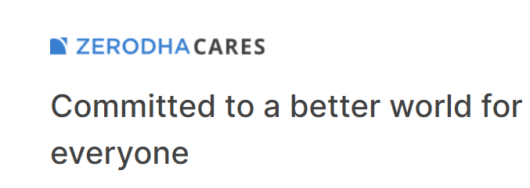
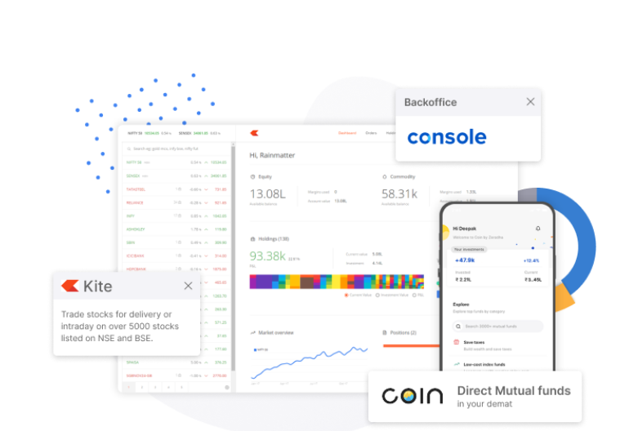
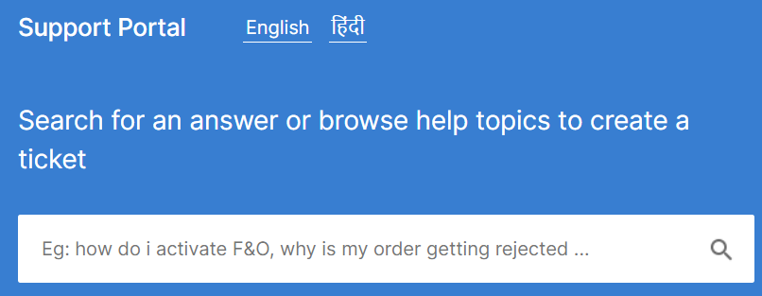
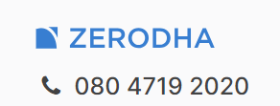
© 2010 - 2023, Zerodha Broking Ltd.
All rights reserved.

Slide 11
DISCLAIMER:
THIS POWERPOINT PRESENTATION IS NOT SPONSORED OR CLIENT-BASED. THIS IS A SAMPLE FOR MY WORK PORTFOLIO WHICH IS JUST A “COMPANY PROFILE” OF ZERODHA.
(For Research and Writing/Design Sample Purpose Only)

